Slide 1



Marketing Campaign Analysis
Presented by: Maaz Ansari, Haoxuan Chen, Carolina Cortes-Rivera & Diomarys Hernandez

Slide 2
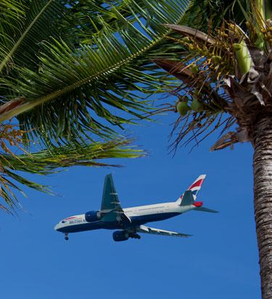

AGENDA
01
02
Introduction
Client / Audience
03
04
KPIs & Visuals
Ad Performance
.
05
06
Recap & Insight
Q&A
Notes:
Scenario and key questions
Age group and background data

Slide 3


Introduction
Scenario: Our marketing agency is working with Expedia to help them improve their marketing campaign for 2025. They are seeking a solution to help them reach prospecting audiences and promote their new ad products.
Objective: Analyze key performance indicators related to ad spend, customer engagement, and behavior to enhance targeted ad strategies and identify the top-performing age groups, countries, and ad types.
?

Slide 4


Our Client:
Background:
Originally launched in 1996 by Microsoft. Expedia is now a popular online travel platform that allows users to book flights, hotels, rental cars, and vacation packages worldwide. Expedia serves as a primary hub for travelers seeking convenient and competitive booking solutions.
?
Scope: Focus on providing valuable insights by analyzing ad performance across key age groups.

Slide 5



Data Overview
\

Slide 6
Data Overview
Age Group | SUM of Impressions | SUM of Clicks | SUM of Spend
18-24 | 907,363,446 | 32,532,618 | 42864803.6
25-34 | 1,970,566,953 | 77,194,896 | $100,395,619.81
35-49 | 5,410,417,893 | 224,555,403 | $283,457,120.53
50-64 | 7,024,265,697 | 314,772,768 | $403,133,007.78
65+ | 3,798,107,766 | 183,822,879 | $258,613,365.46
01
Age group ranging from 50-64 have the highest average impressions, clicks and spendings
02
Age group 18-24 have the lowest average impressions clicks and spendings
Notes:
Overview of Data
Age group ranging from 50-64 have the highest average impressions clicks and spendings
Age group 18-24 have the lowest average impressions clicks and spendings
Let’s dive into what ads your company should keep running to the target age group 50-64

Slide 7
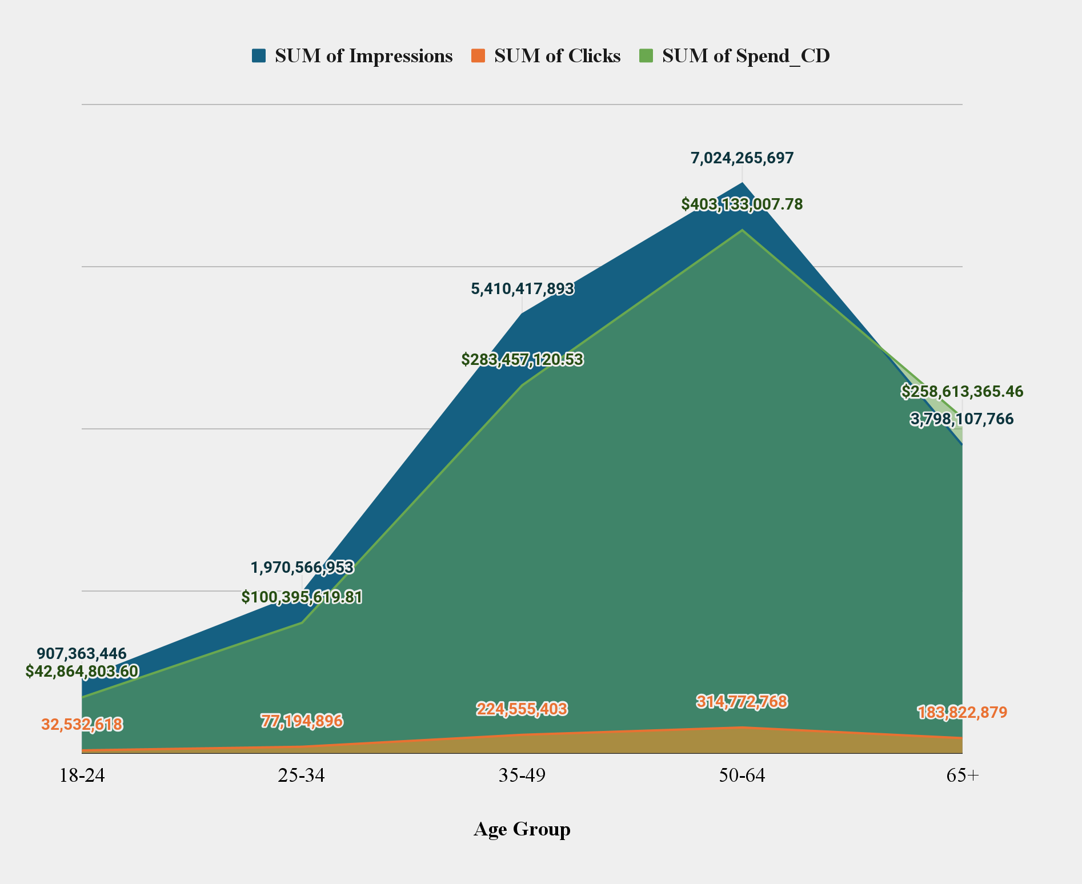
Ad Engagement by Age Group
SUM Impressions, Clicks and Spend Across Age Groups
01
50-64 yr olds engage the most with ads but were also spending the most on them
02
Overall, we spent $403M to get 7B impressions and 314M clicks for this age group
Notes:
Avg clicks 50-64: 6,594 vs 18-24 682 clicks

Slide 8
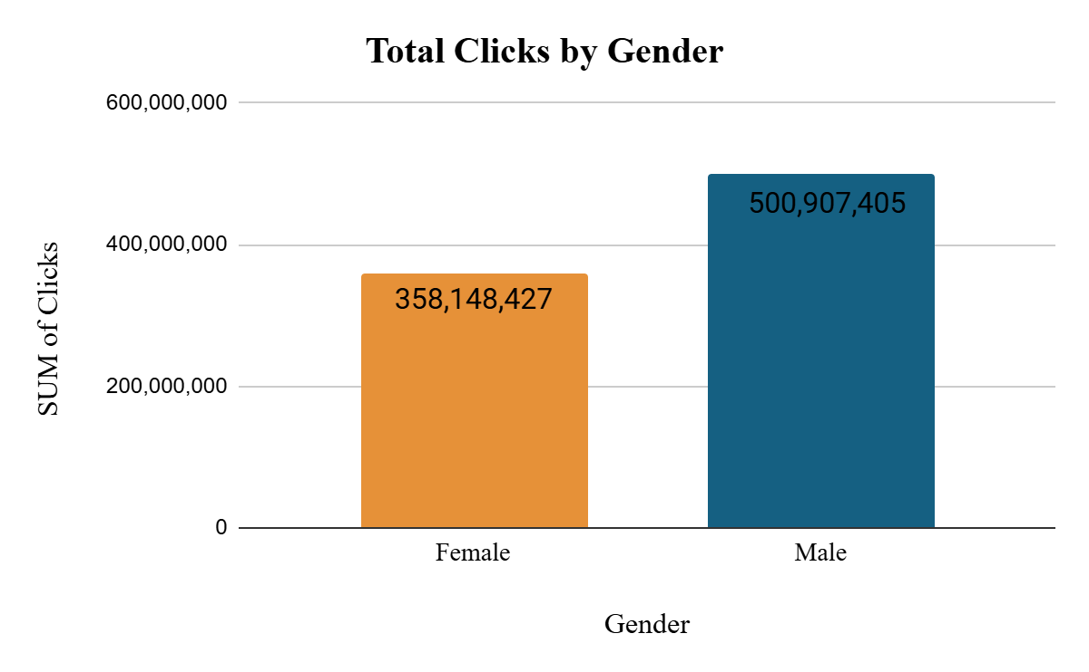
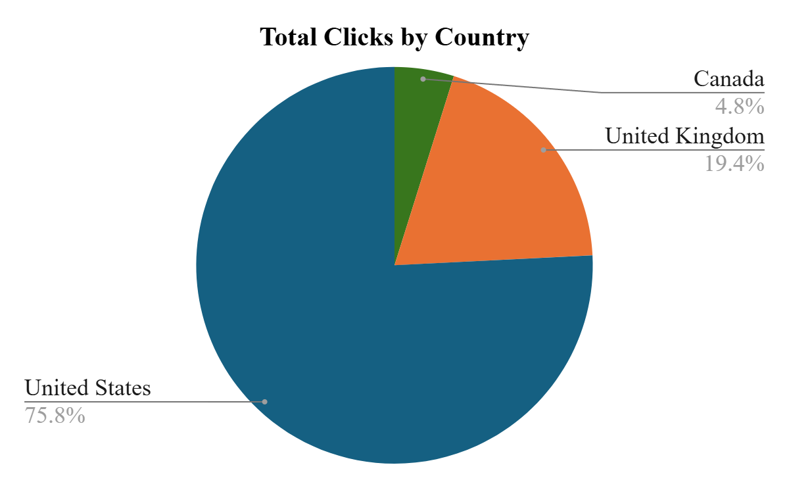
Demographics
01
Approximately ⅓ of Male consumers are more interested in our ads compared to females
02
The customer base we studied reside in U.S, U.K, and Canada

Slide 9


KPI’s Analyzed
CPM
CTR
CPC
CAC
Click Through Rate
Cost Per Click
Customer Acquisition Cost
Cost Per Thousand
Clicks / Impressions
Total ad cost/ total clicks
Total spend/ total impressions
(Total Spend/ Impressions) * 1000

Slide 10

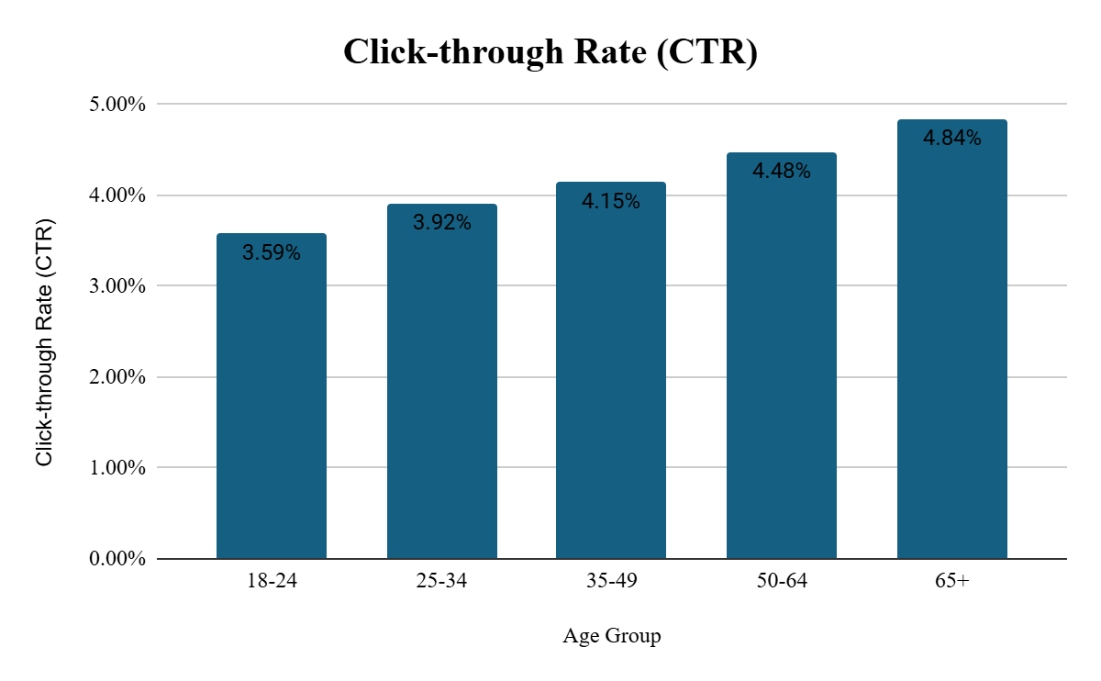
CTR: Click Through Rate
01
The 50-64 age group are highly interested in our ads
02
As the age group increases consumers become more interested in travel

Slide 11
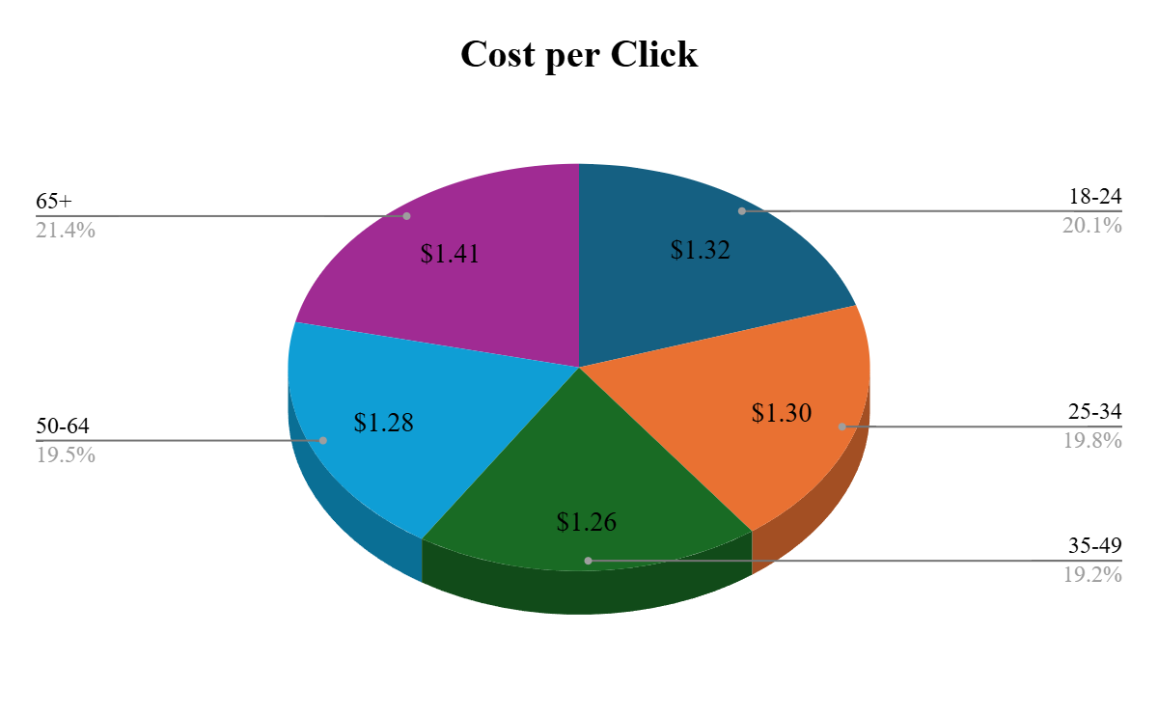
CPC: Cost Per Click
01
Cost per Click for the 50-64 age group is $1.28
02
The 35-49 age group has the lowest cost per click

Slide 12
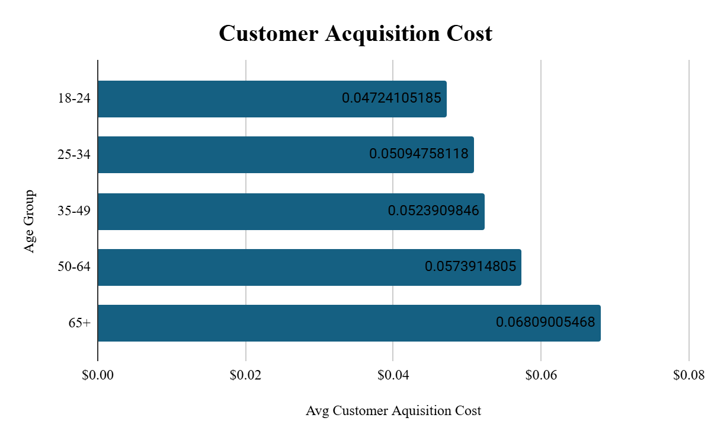
CAC: Customer Acquisition Cost
01
It is costly to acquire members from the 50-64 age group

Slide 13
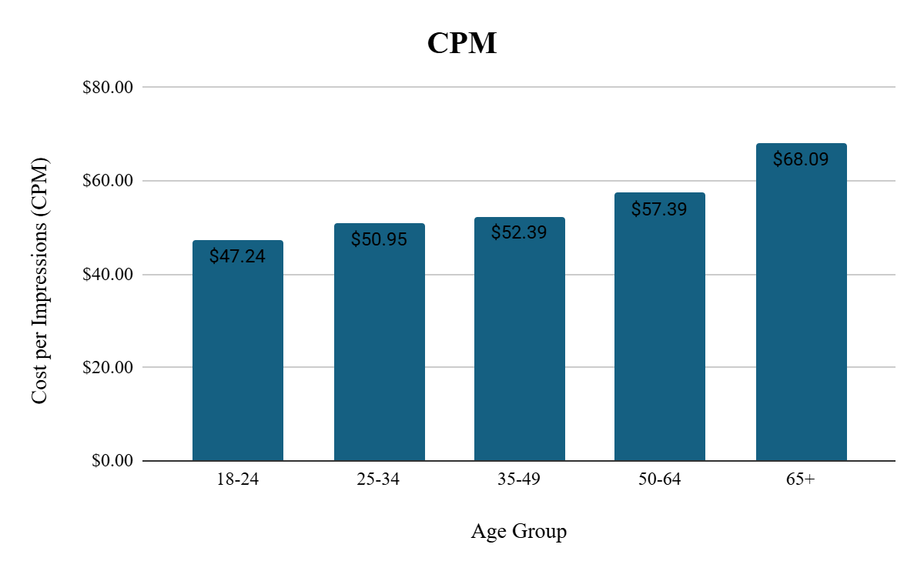
CPM: Cost Per Thousand
01
For every 1000 Impression it costs up to around $60 for the 50-64 age group

Slide 14
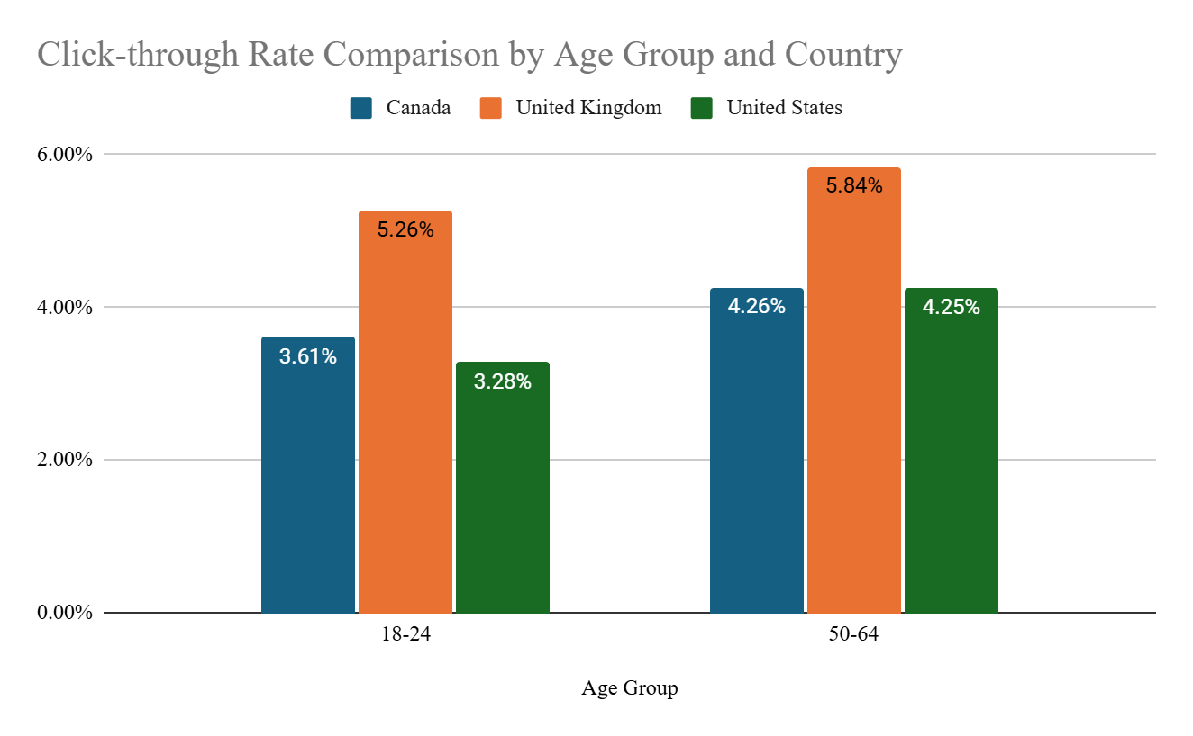
CTR: 18-24 and 50-64 Age Groups
In Canada, the 50-64 age group engages slightly more with ads, outperforming the 18-24 group by a small margin.
In the UK, the 50-64 group leads with the highest CTR overall, indicating ads are resonating well with older audiences.
In the US, the 50-64 group clicks on ads more often than the 18-24 group, showing higher engagement among older users.

Slide 15
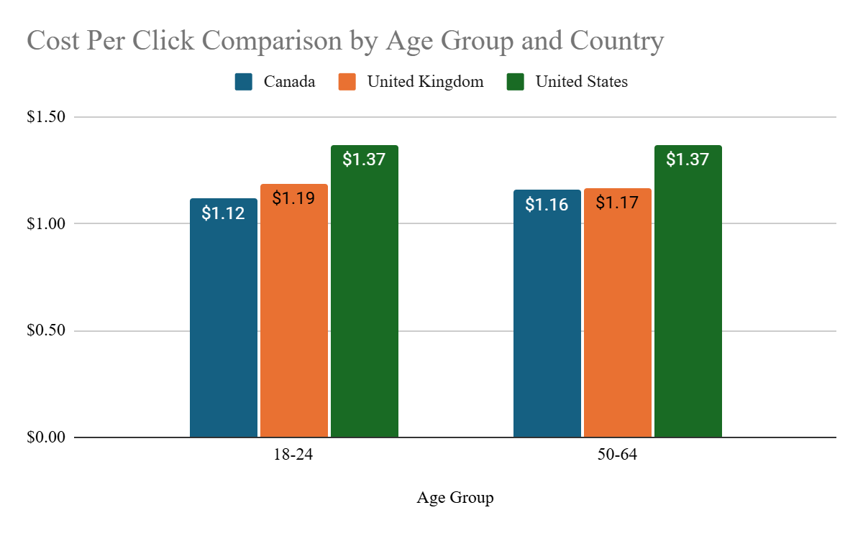
CPC: 18-24 and 50-64 Age Groups
Canada shows a small difference between the age groups, with the 50-64 group having slightly higher costs than the 18-24 group.
The UK sees the opposite trend, with the 50-64 group costing slightly less per click, showcasing cost efficiency for older audiences.
The US maintains the same CPC for both age groups, indicating no significant cost variation by age.

Slide 16
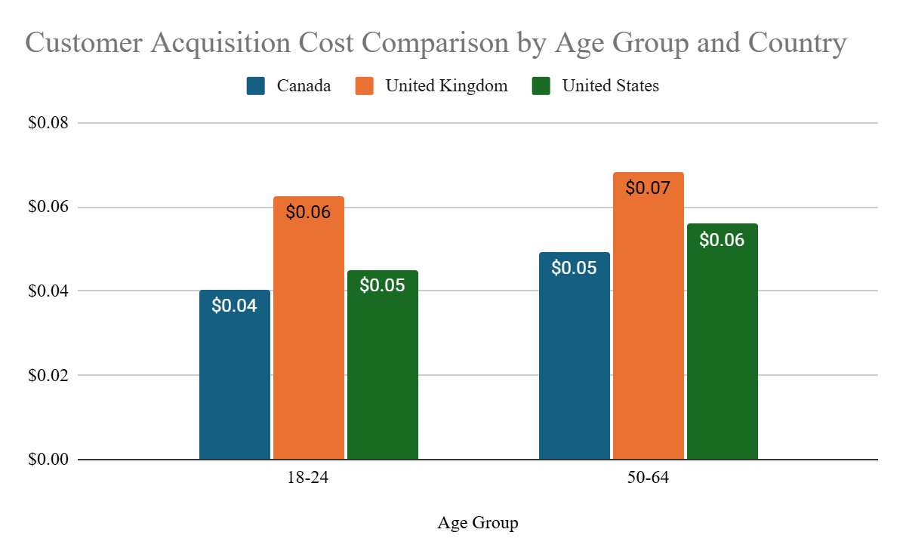
CAC: 18-24 and 50-64 Age Groups
In Canada, the 50-64 group has a slightly higher CAC than the 18-24 group, though both remain cost-effective for converting customers.
The UK, the 50-64 group costing more to acquire, making the younger demographic a more efficient target.
In the US, the CAC for the 50-64 group is higher but there is only a small difference

Slide 17
Performance Across Ad Types
\

Slide 18
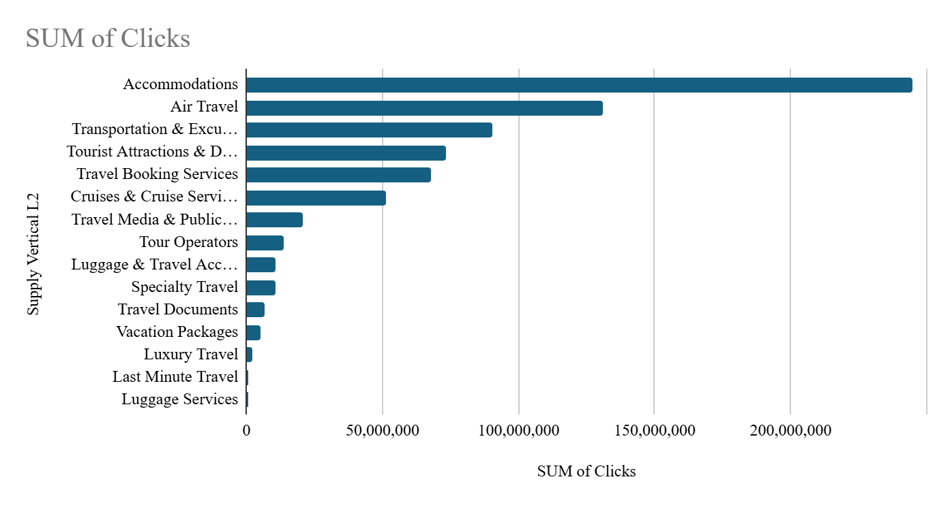
Overview of Ad Type Popularity
Overall, the most clicked on ads are:
Accomodations
Air Travel
Transportation & Excursions
Tourist Attractions & Destinations
Travel Booking Services
.

Slide 19
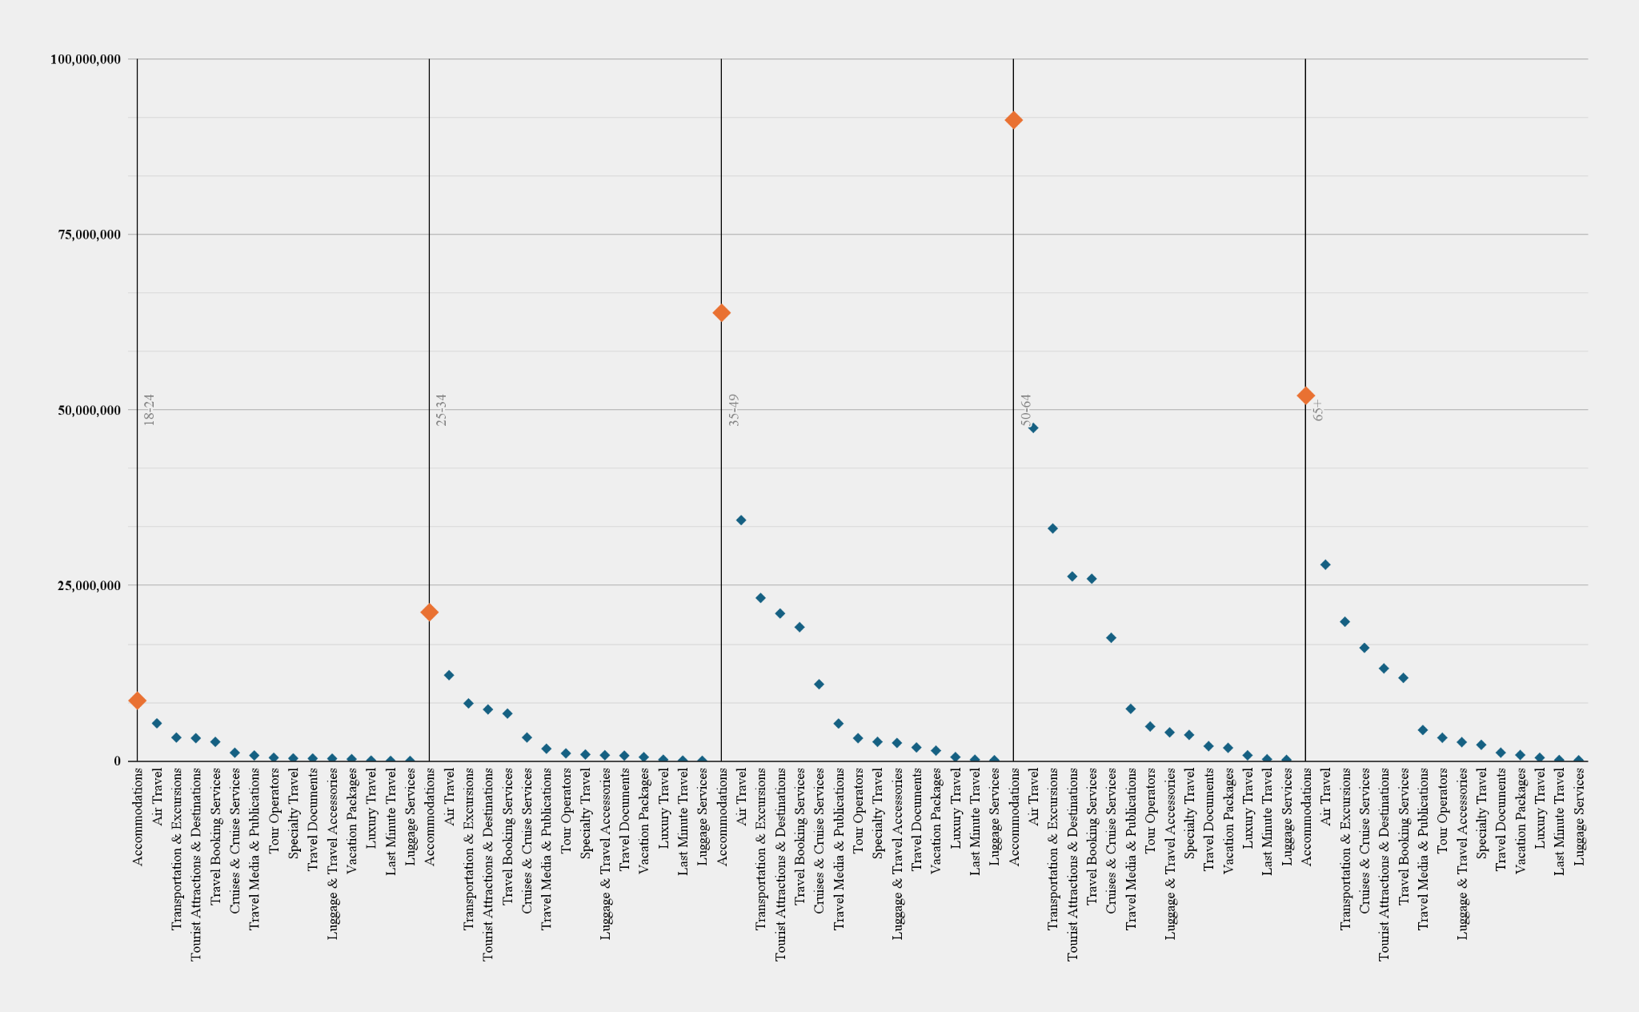
Ad Type Popularity Across Age Groups
Accommodations most clicked on across all age groups
Mainly by 50-64, 35-49, and 65+
.
Notes:
50-64: 91K
34-49: 63K
65+: 52K

Slide 20
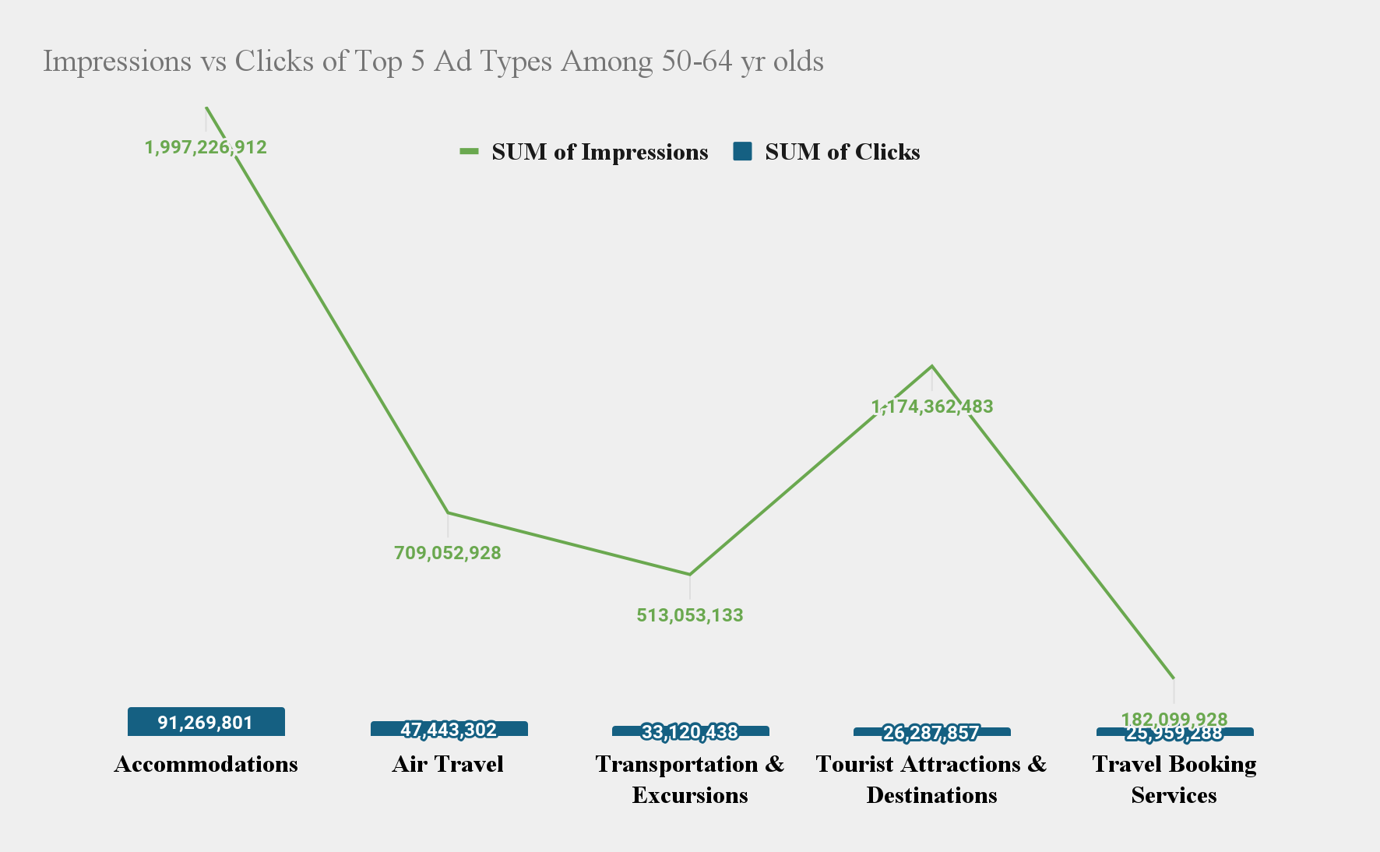
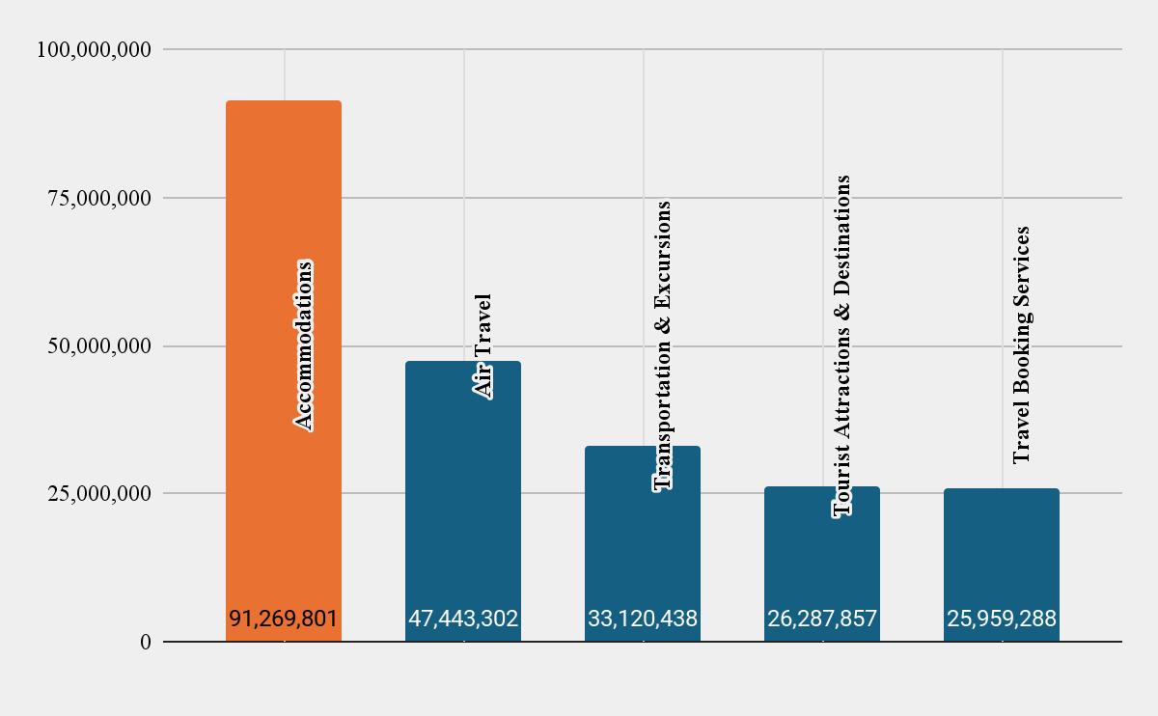
Comparing Performance of Top 5 Travel Ads for 50-64 Yr Olds
.
Accommodations has the most impressions and is followed up by the top 4 Ad category: Tourist Attractions & Destinations

Slide 21
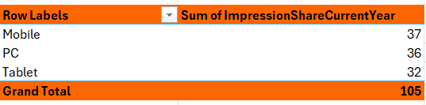
Mobile and PC Ads Perform Better
105 impressions
Ads are most seen on mobile but the difference between PC and Mobile is minimal
Devices & Impressions - Travel Data 2023

Slide 22
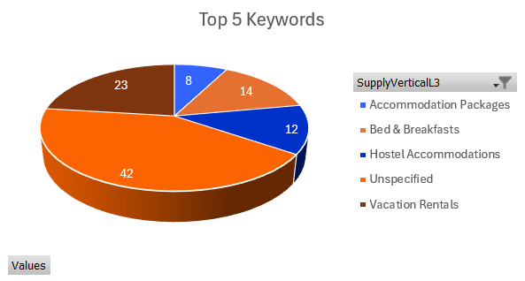
Travelers are Interested In Comfort Stays
102/105 unspecified category
65/102 of the unspecified are under the owned and operated vertical
Keyword Searches - accommodations

Slide 23
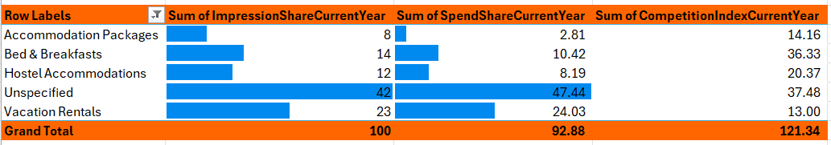
Top 3 Accomodations
01.
Unspecified has the highest search volume and spend. CI 58.13 the previous year.
02.
Vacation Rentals is the second one on search volume and spend. CI 12.73 the previous year.
03.
Bed & Breakfast is the next best keyword for search volume and spend, even though the CI went up from the previous year. CI 13.21 the previous year.

Slide 24
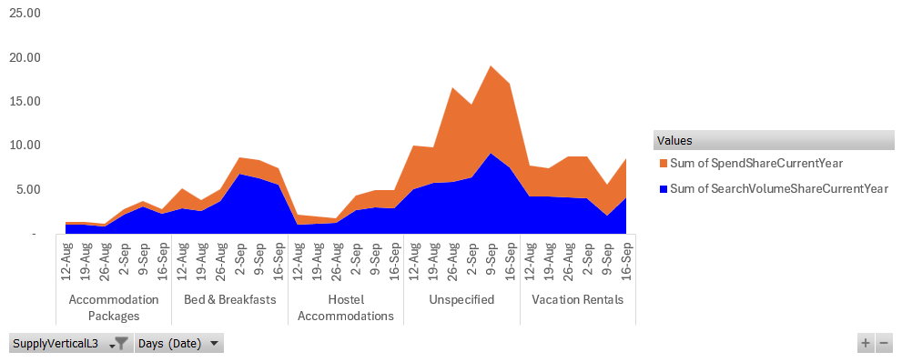
Travel Searches Increases as We Approach the Fall
Search volume and spend share increases as we move into the Fall for each of these top categories

Slide 25


Key Takeaway Points and Recommendations
For the 50-64 age group, they may have more disposable income and are likely exploring products or services that cater to their established preferences or needs, such as travel, healthcare, or financial services.
For the 18-24 age group, high competition among ad platforms targeting this age group often leads to lower bid requirements to capture their attention.
Collaborating with owned and operated accommodations to develop a referral points program that rewards guests staying at these properties
Partnering with a credit card company or creating an exclusive card offering tailored to the age group that travels most frequently
.

Slide 26
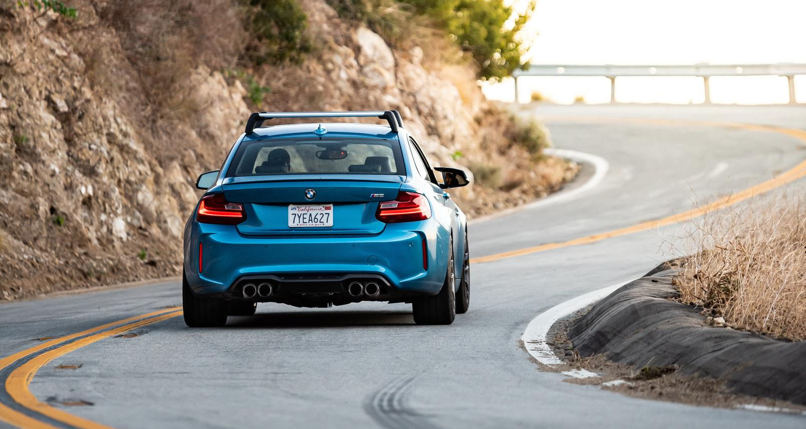



Thank you!
Questions?

